Slide 1

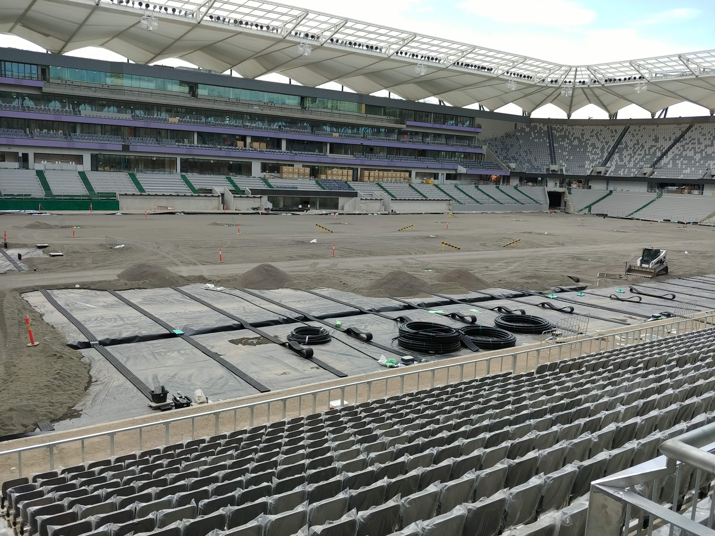
Time Out
Bankwest Stadium Evacuation
Steven Molino

Slide 2
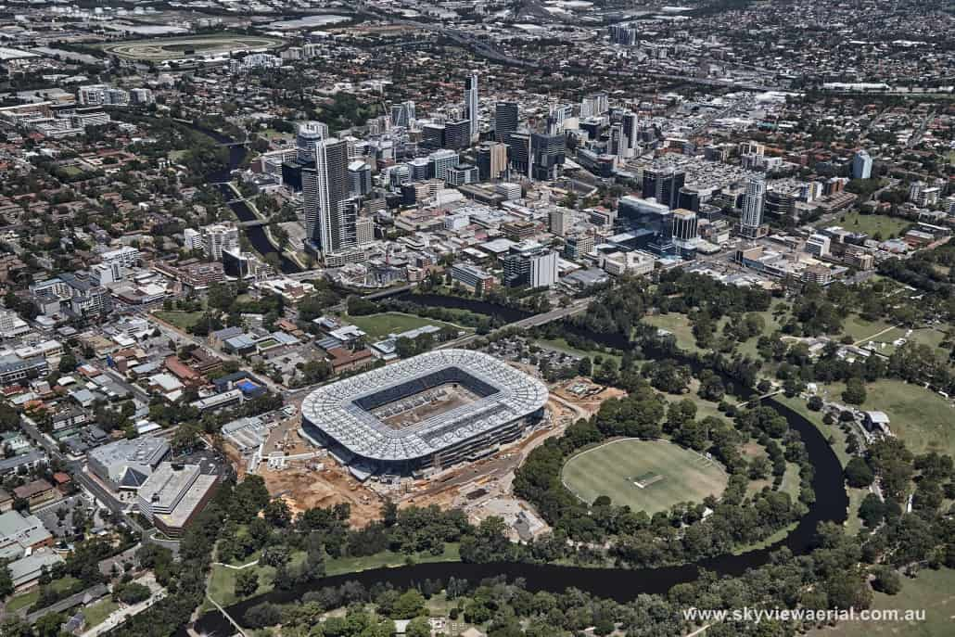
Overview
Development
Flooding
Challenges
Response strategy
Photo from: bankweststadium.com.au

Slide 3
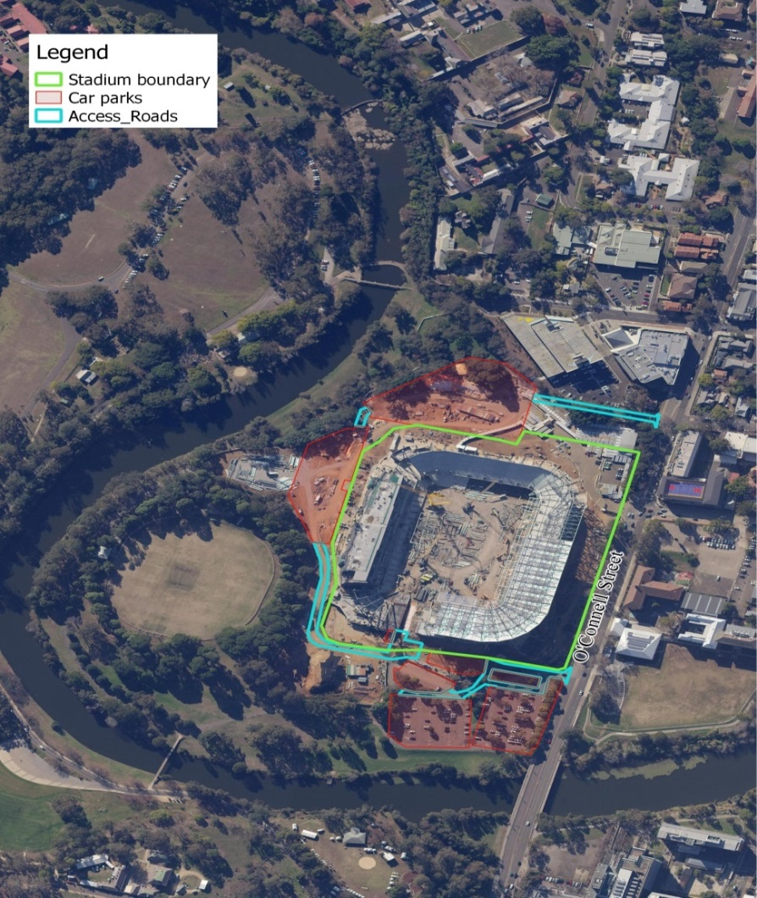
1. Development
Redevelopment and expansion
North of Parramatta CBD on bend of river
Three car parks for a total capacity of 827 cars
One access road (north and south)

Slide 4
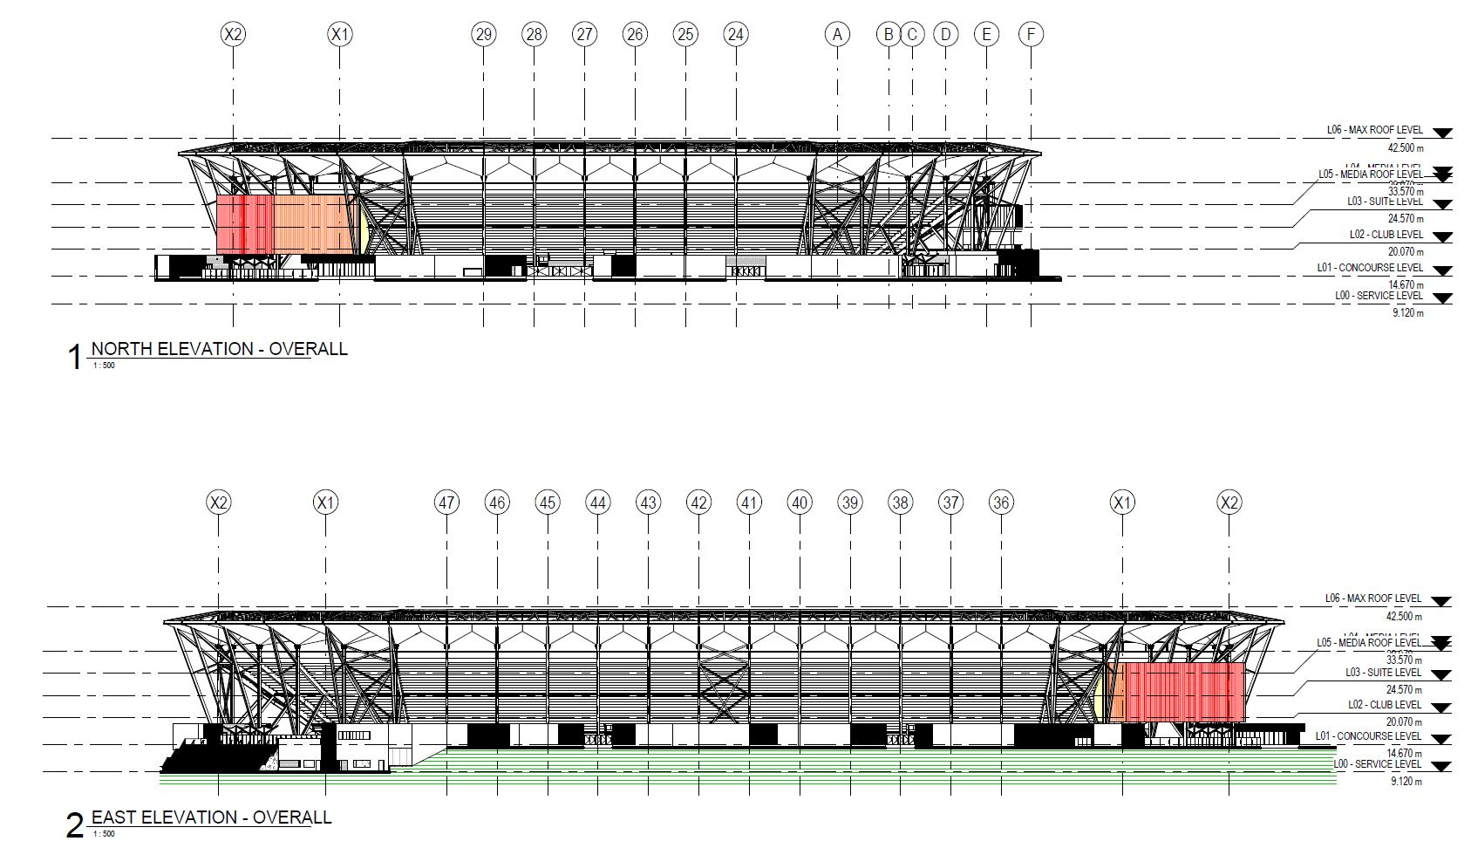
Six levels
  L00 (RL 9.12 m) – Service: Pitch and utilities
  L01 (RL 14.676m) – Concourse
  L02 to L06 include club and suite rooms, media space

Slide 5
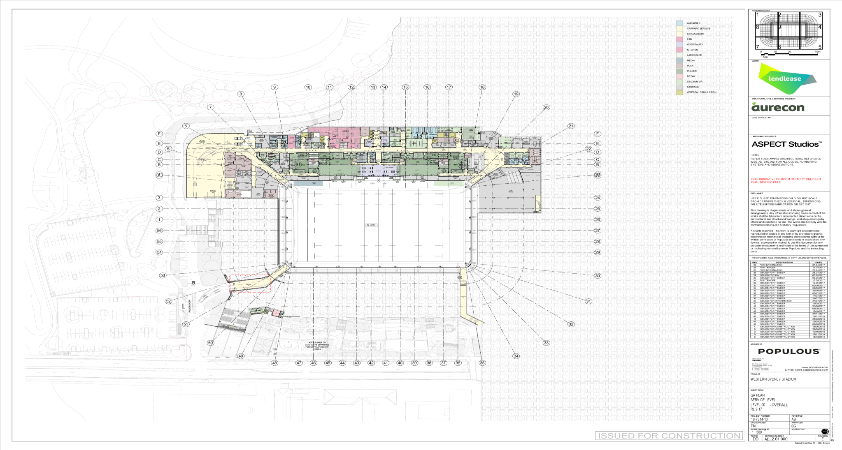
L00 (RL 9.12 m) – Service level

Slide 6
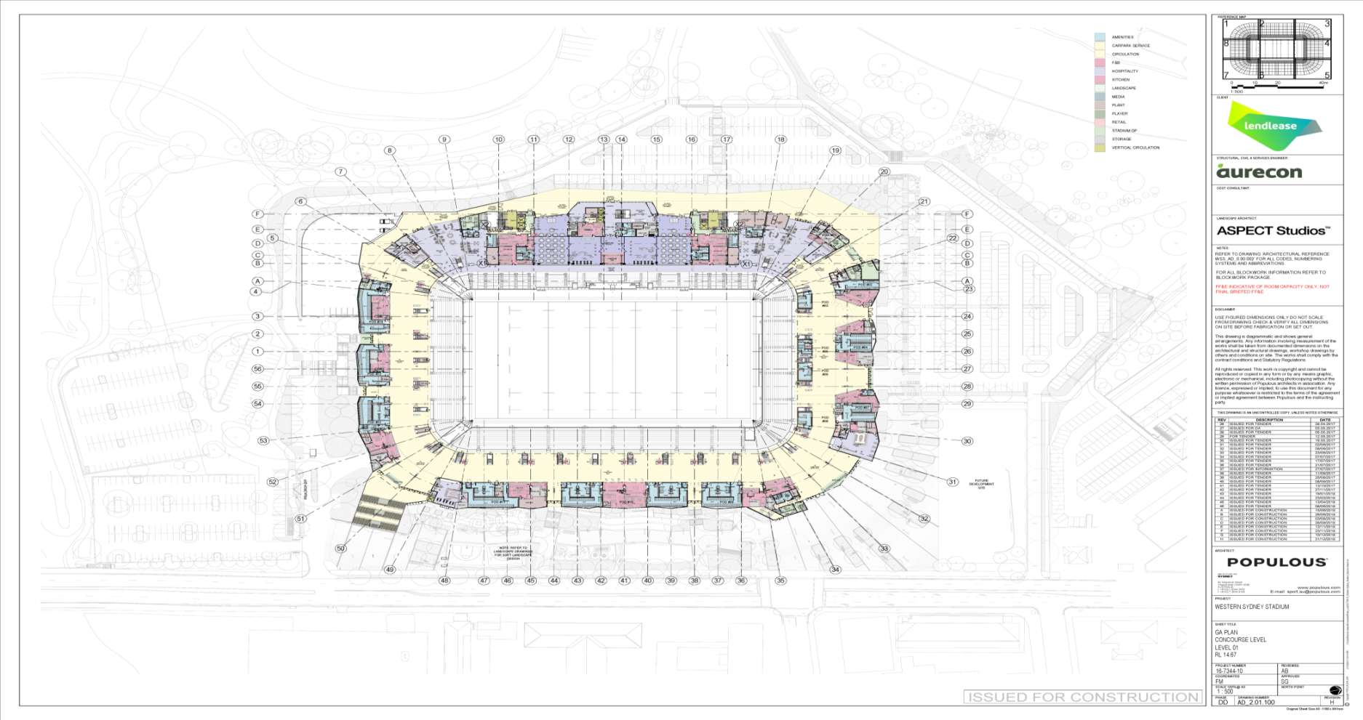
L01 (RL 14.676m) – Concourse

Slide 7
Approval condition is FEMP before operation
Venue operator appointed when construction works almost completed
No input to design
First event 14 April 2019

Slide 8
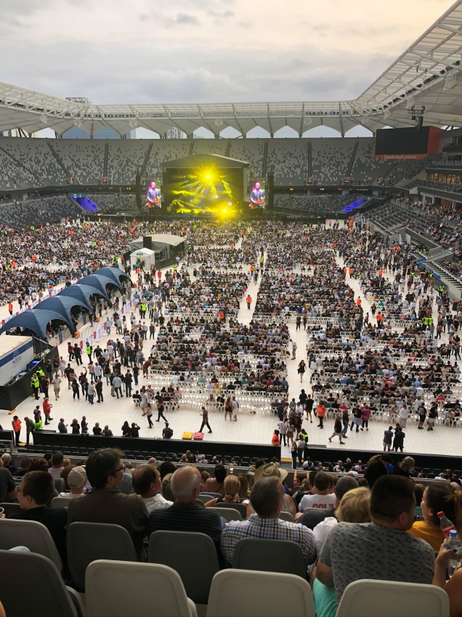
Operation
EVENTS (activities using the playing field)
  40 - 50 sport events per year - up to 30k patrons
  2 concerts per year - up to 40k patrons
  2-3 hours duration
  Door opening 2 hours before start
  Clear of all patrons within 1 hour after event
  Most patrons on foot
  Car parks expected to be full (827 spots)
FUNCTIONS (activities not using the playing field)
  Up to 800 patrons
  Any day of year
  Car parks partially full

Slide 9
Development
Flooding
Challenges
Response strategy
Photo from: bankweststadium.com.au

Slide 10
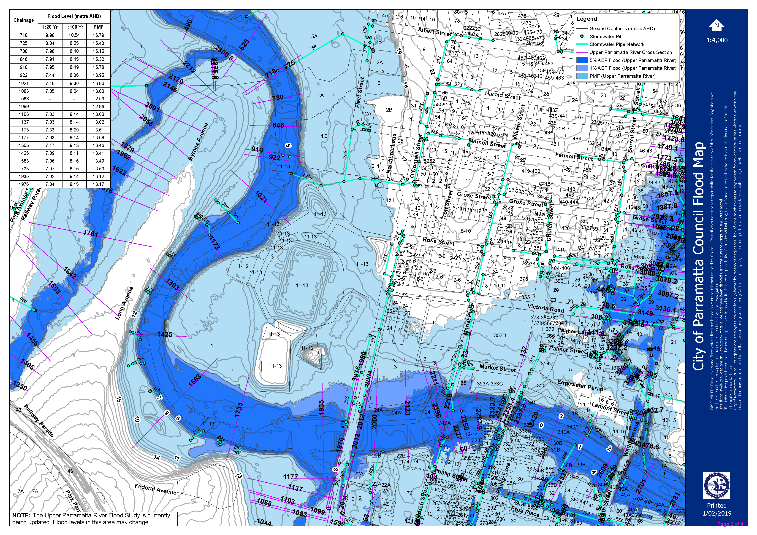
5% AEP: 7.04m AHD
1% AEP: 8.15m AHD
PMF: 13.17m AHD

Slide 11
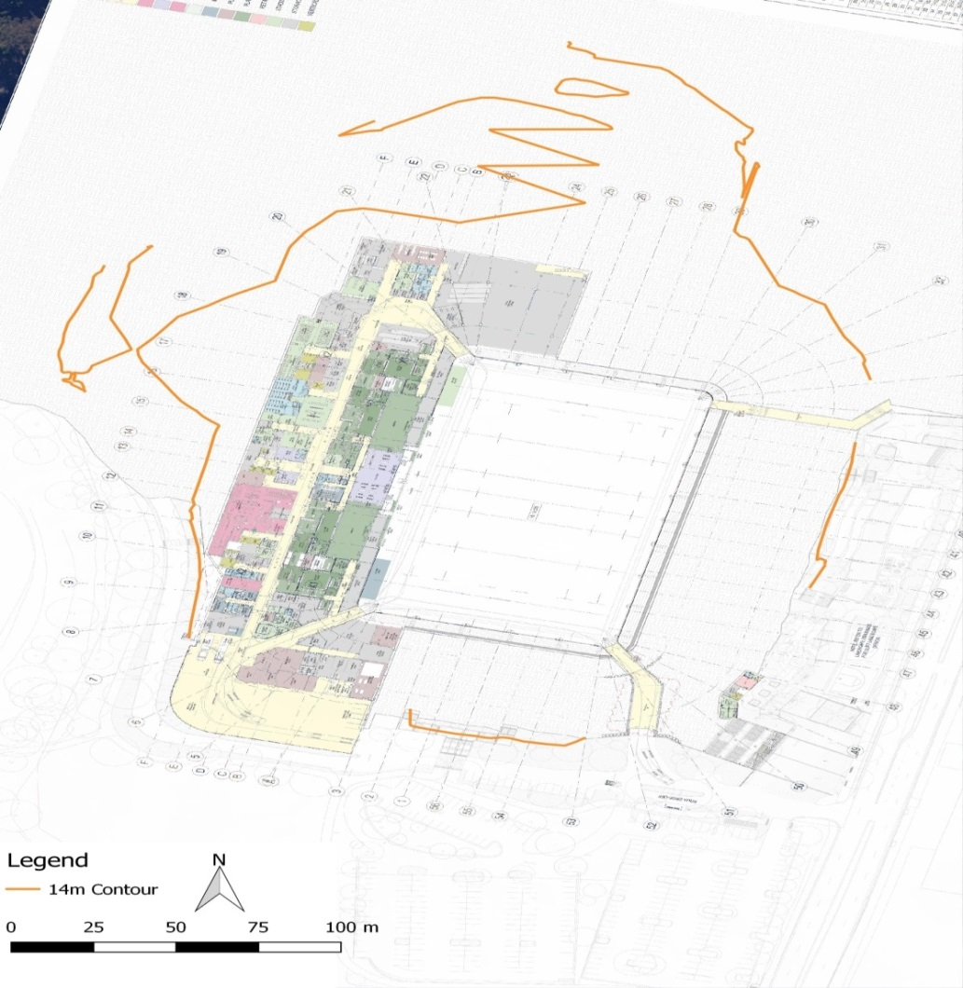
Topography
Local topography altered by cut and fill operations associated with the construction works
PMF extent may be smaller than what shown in model

Slide 12
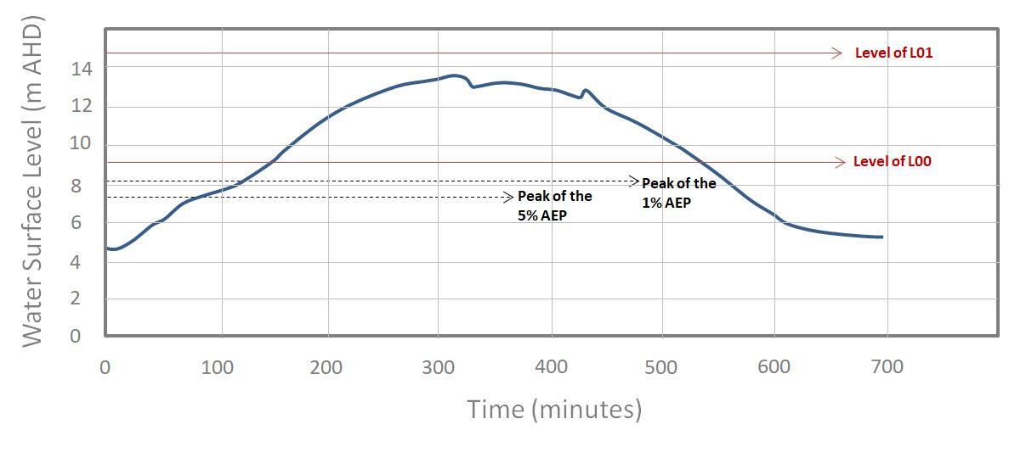
Flood Rate of Rise and Duration in PMF

Slide 13
Development
Flooding
Challenges
Response strategy
Photo from: bankweststadium.com.au

Slide 14
Challenges
Maybe 2hrs flood warning
Car parks flood early
Public transport on other side of river
Where evacuate to?
Need balance between:
  Calling unnecessary cancellations
  Having large numbers stranded

Slide 15
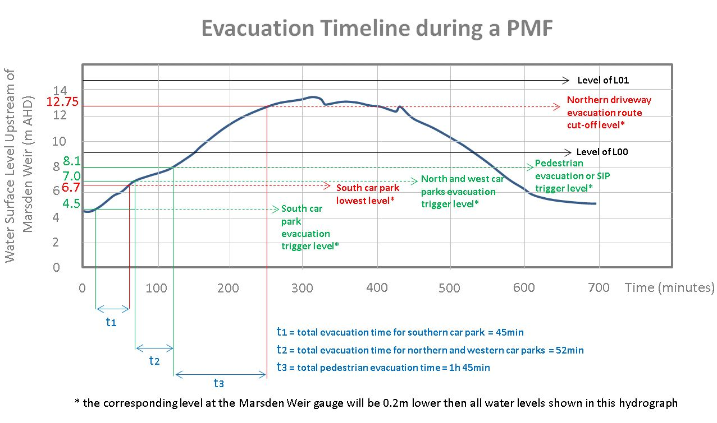
Proposed strategy

Slide 16
Development
Flooding
Challenges
Response
strategy
Photo from: bankweststadium.com.au

Slide 17
Multi-staged plan
With escalating alert modes
Multiple response triggers
Three responses:
  Cancel
  Leave early
  Stay

Slide 18
Alert Modes
Yellow: flooding possible within 24 hrs
Orange: possible southern car park flooding in the next 2 hrs
Red: site flooding possible in next 2 hrs
Black: site flooding possible within 1 hr

Slide 19
 | YELLOW Flooding of the site possible within 24 hrs | ORANGE Flooding of the southern car park possible within 2 hrs | RED Flooding of the site is possible within 2 hrs | BLACK Flooding of the site is possible within 1 hr
BoM Severe Weather Warning for the Parramatta Area | A Severe Weather Warning is issued OR↴ | Not Applicable | Not Applicable | Not Applicable
BoM Flood Watch issued for Parramatta River | A Flood Watch is issued for the Parramatta River OR↴ | Not Applicable | Not Applicable | Not Applicable
City of Parramatta Floodsmart warning system | A MINOR flood warning is issued | A MODERATE flood warning is issued OR↴ | A MAJOR flood warning is issued OR↴ | Not Applicable
Marsden Weir live gauge reading AND BoM forecast rainfall | Not Applicable | Marsden Weir gauge reading = 0.56m AND 24h forecast rainfall is 50mm or greater OR↴ | Marsden Weir gauge reading = 3.06m OR↴ | Marsden Weir gauge reading = 4.16m OR↴
Visual Observation | Not Applicable | Floodwaters are sighted in the green area between the southern car park, the river and O’Connell Street OR↴ | Floodwaters are sighted entering the southern car park OR↴ | Floodwaters are sighted half way through the southern car park OR↴
Direct communication from NSW SES | Not Applicable | Received advice that the southern car park may flood. | Received notification that a MAJOR flood is expected | Received evacuation order

Slide 20
Thank you

